Slide 1

Project Report on: Spaceship Titanic
Project Number : 01
Project Submitted by : Karthik V M
Document Type: Low level Document

Slide 2

INTRODUCTION:
The event of occur – 2912
To solve a Cosmic mystery
Data – 4 lightyears away
It was an interstellar passenger liner launched a month ago(13000)
Collided with a spacetime anomaly hidden within a dust cloud.

Slide 3
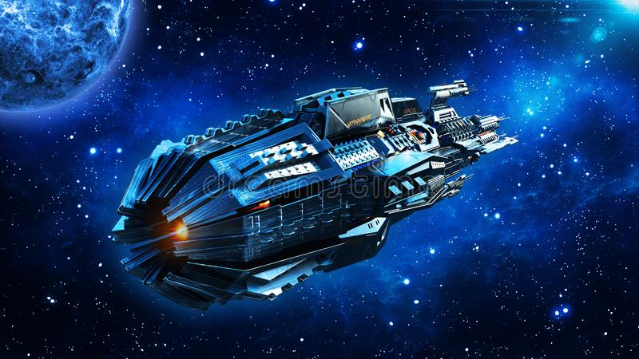
PROBLEM STATEMENT (Business level)
To help rescue crews and retrieve the lost passengers
Challenged to predict which passengers were transported by the anomaly
By using records recovered from the spaceship’s damaged computer system

Slide 4
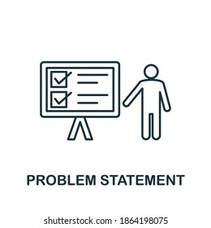
PROBLEM STATEMENT(ML/DL)
Objective: To predict whether the passenger is transported or not
Data: It contain information of 8693 which include PassengerID, Cryosleep, Age, Name, VIP, VRDeck, FoodCourt, ShoppingMall, Spa and Homeplanet.
Evaluation Matrix: Accuracy
Assumptions: The data is representative of population of passenger on the spaceship titanic and is accurate and complete.
Expected Results: should be able to predict the Transported of passenger on Spaceship titanic with accuracy of at least 75%

Slide 5





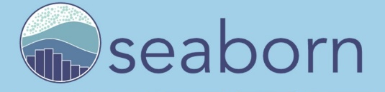
SOFTWARE REQUIRED
TOOLS USED
Google Colab- Notebook
LIBRARIES USED
Data Analysis: Numpy, Pandas, Sci-kit Learn
Data Visualization: Matplotlib, Seaborn

Slide 6
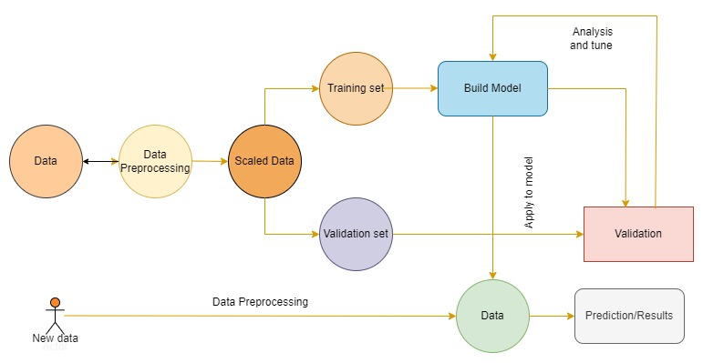
WORKFLOW DIAGRAM

Slide 7



IMPORTING LIBRARIES:

Slide 8
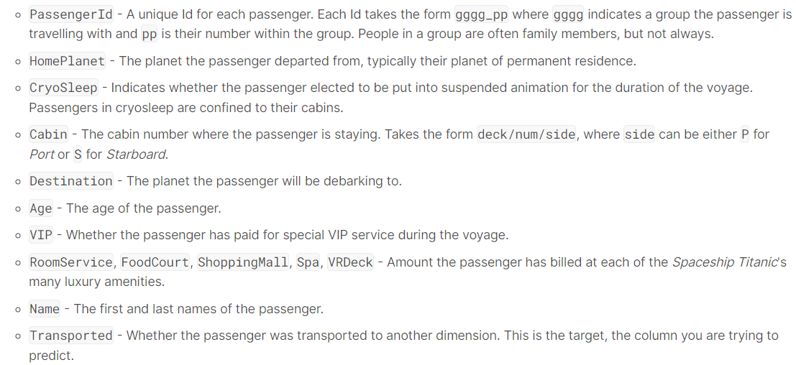
DATA DESCRIPTION

Slide 9
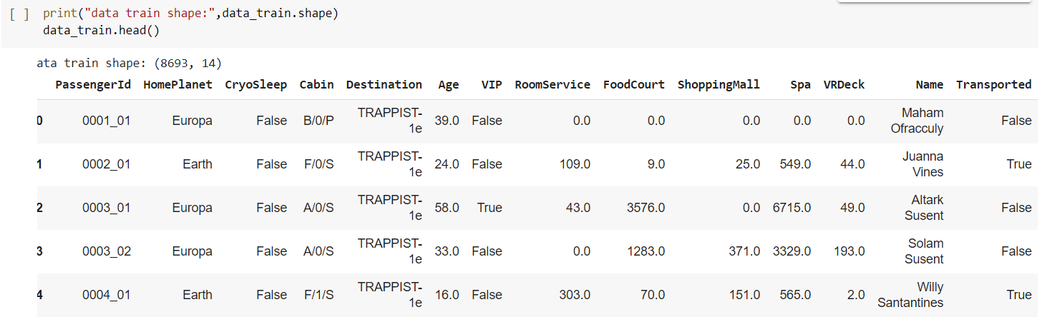
IMPORTING DATASET

Slide 10
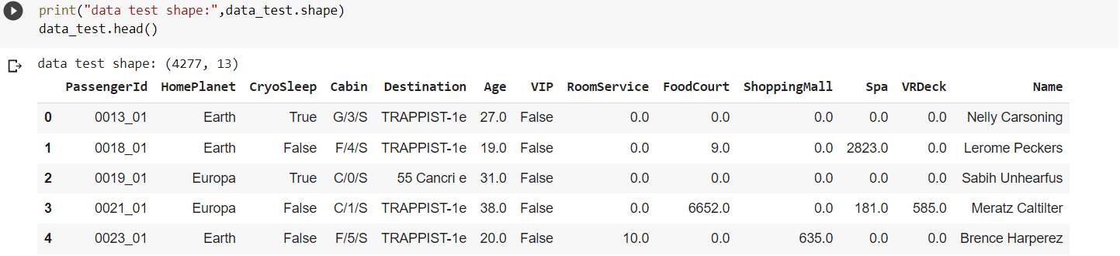

Slide 11
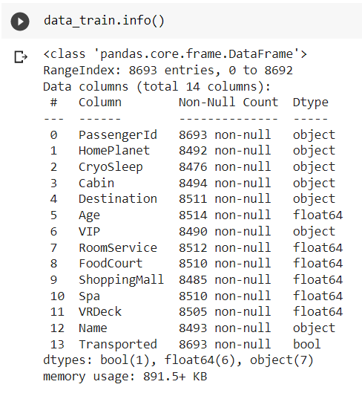
INFORMATION OF THE DATA:
Total number of column
Total number of rows
Column Names
Column Dtype (Data types)

Slide 12
DATA PREPROCESSING:
Handling missing values
Checking Duplicate values
Creating new features
PassengerId – format of group and group number
VRDeck – Deck & side separated

Slide 13
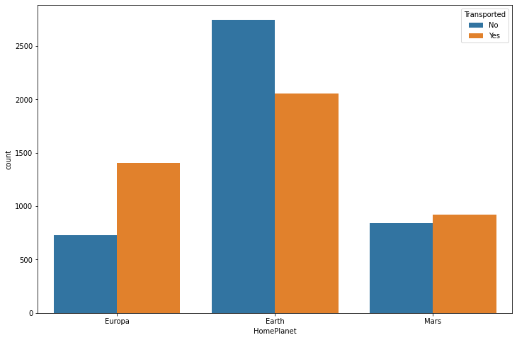
DATA VISUALIZATION:
How independent variable is affecting the Transportation ?
HOME PLANET

Slide 14
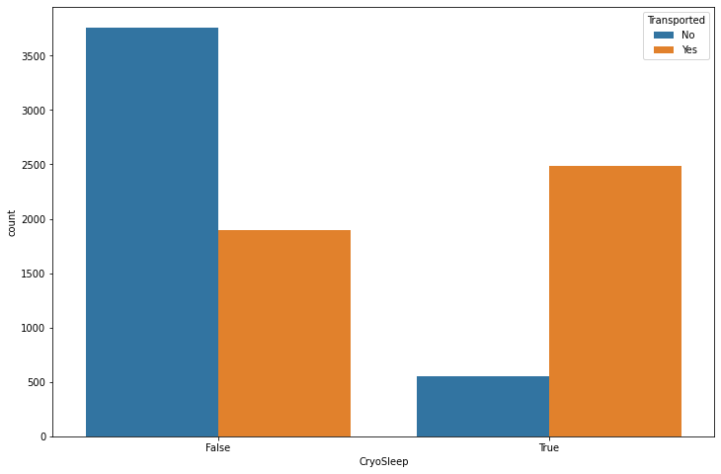
DATA VISUALIZATION continue..
CRYOSLEEP

Slide 15
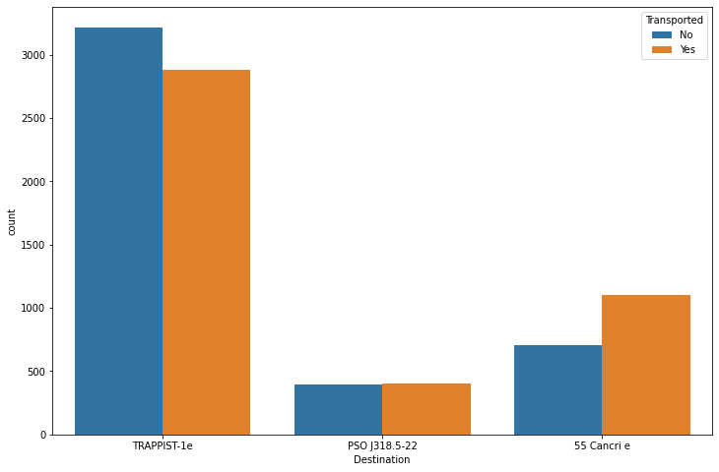
Data Visualization continue…
DESTINATION

Slide 16
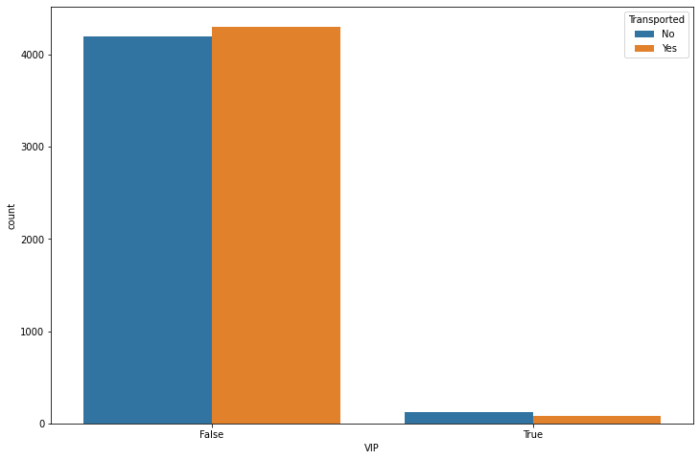
Data Visualization continue …
VIP

Slide 17
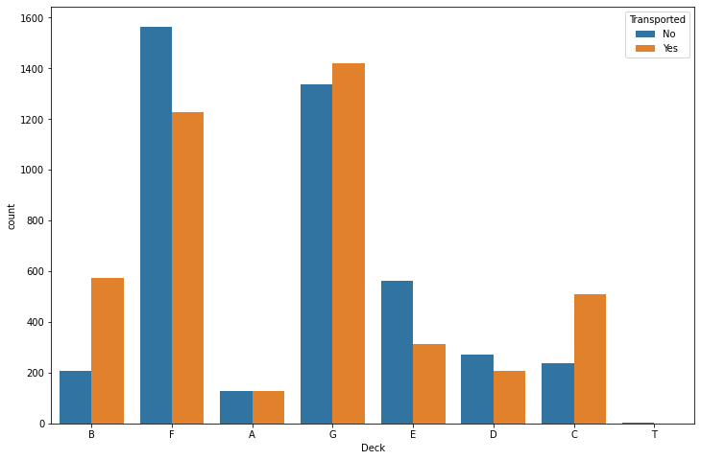
Data Visualization continue …
DECK

Slide 18
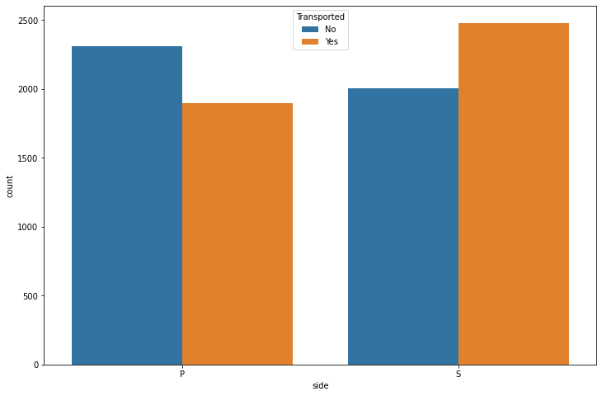
Data Visualization continue …
SIDE

Slide 19
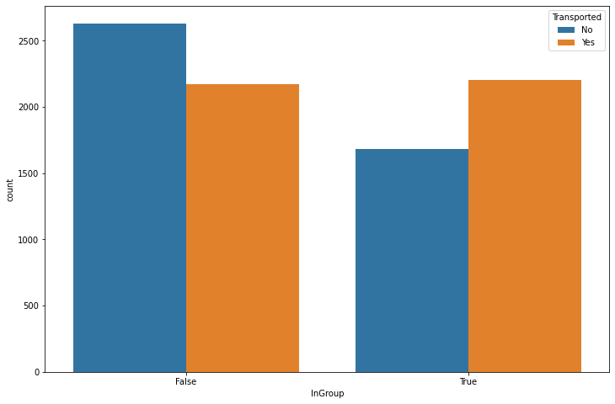
Data Visualization continue …
INGROUP

Slide 20
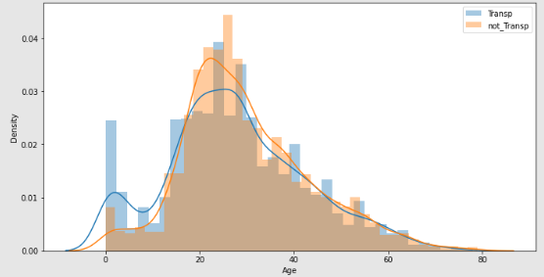
Data Visualization continue …

Slide 21
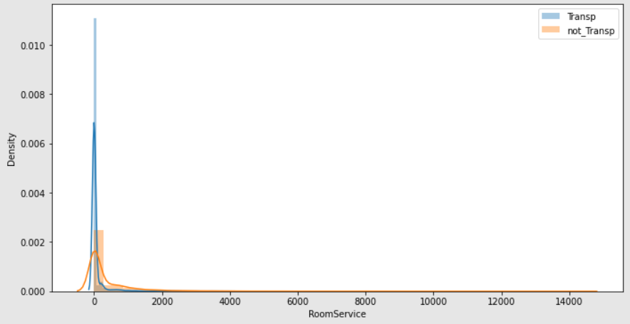
Data Visualization continue …

Slide 22
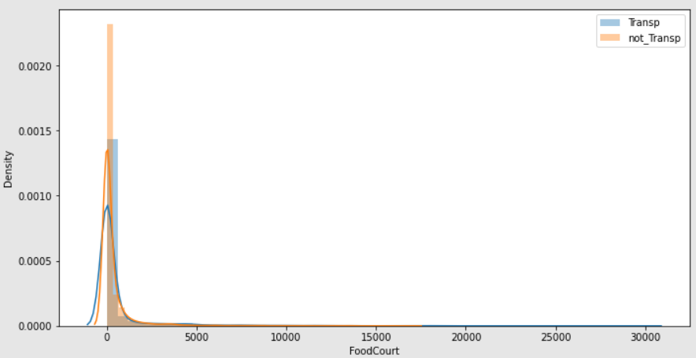
Data Visualization continue …

Slide 23
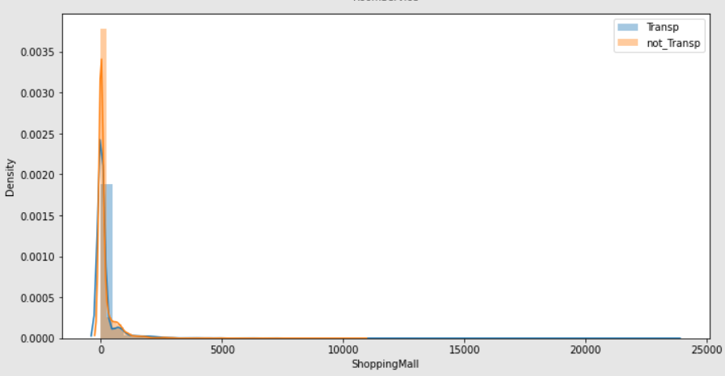
Data Visualization continue …

Slide 24
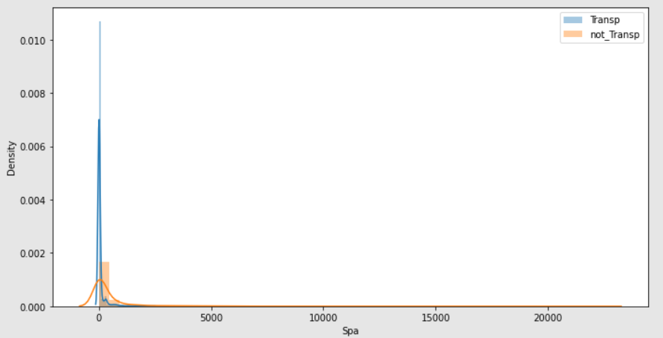
Data Visualization continue …

Slide 25
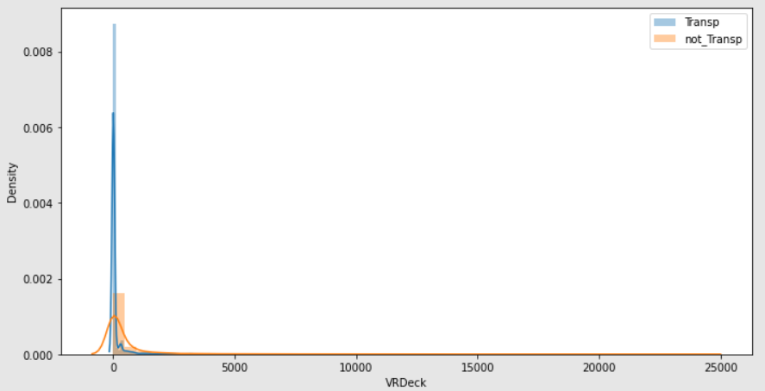
Data Visualization continue …

Slide 26
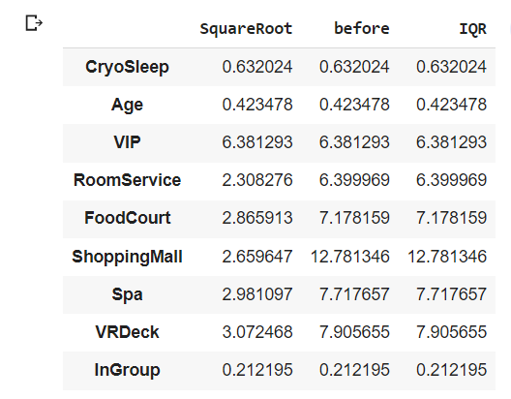
REMOVING OUTLIERS
Dataset is Balanced and contain zero values in it.
Square root Transformation and Interquartile range is used to Normalize the data distribution
Square Root transformation is selected to minimize the highly right skewed data

Slide 27
MODEL BUILDING:
Creating basic model
Train the model with train data
Evaluating the model with Val data
Tuning the model
Identify the best model
Predicting the result with Finalized model

Slide 28
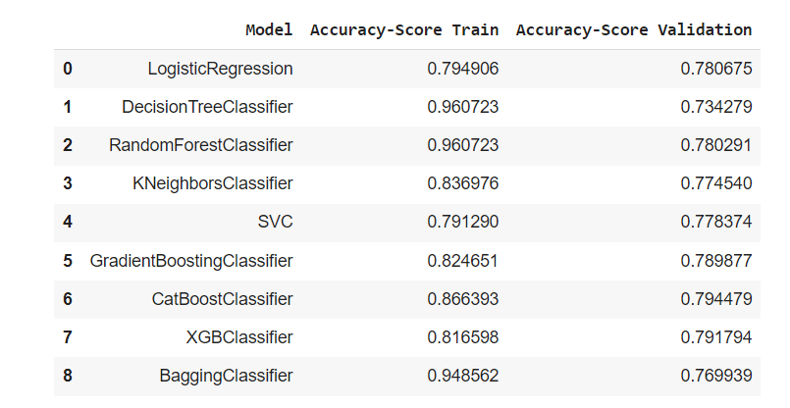
IDENTIFY THE BEST MODEL:
Training with the different basic model for prediction and checking the accuracy
Predicting with the unseen data and checking the accuracy
Select the model on the basis of the accuracy score of train and valuation
Or choose the model which is best fit to predict

Slide 29
Hyperparameter Tuned Model
Hyperparameter Tuning for XGBoost Classifier, Gradient Boosting Classifier and Random Forest Classifier.
As we compare these model prediction the Gradient Boosting Classifier fit better
Training 83.78 and Valuation is 79.21 which is slightly overfit the model
Overfitted : Training is good and predicting is also good
Tuned Model | Accuracy Score Trained | Accuracy Score Valuation
XGB Classifier | 81.13 | 78.71
Gradient Boosting Classifier | 83.78 | 79.21
Random Forest Classifier | 86.12 | 79.06

Slide 30
Finalized Model Confusion Matrix
Confusion Matrix of Gradient Boosting classifier:
True Positive – 970
True Negative – 1096
False Positive – 319
False Negative – 223
Precision score:
Ture Positive/True Positive + False Positive
Recall score:
Ture Positive/True Positive + False Negative
Predicted Label Actual label |  | Predicted Label
 |  | 1 | 0 | Total
Actual Label | 1 | 970 | 319 | 1289
 | 0 | 223 | 1096 | 1319
 | Total | 1193 | 1415 | 2608

Slide 31
Prediction On Test Data(Unseen)
Fit the model with best estimator of gradient.
Making prediction using the new model on test data
And make submission file in the format of PassangerID and Transported.
PassengerId | Transported
0013_01 | TRUE
0018_01 | FALSE
0019_01 | TRUE
0021_01 | TRUE
0023_01 | TRUE
0027_01 | FALSE
0029_01 | TRUE
0032_01 | TRUE
0032_02 | TRUE

Slide 32
CONCULSION:
We started with the data exploration where we got a feeling for the dataset, checked about missing data and learned which features are important. During this process we used seaborn and matplotlib to do the visualizations. During the data preprocessing part, we computed missing values, converted features into numeric ones, grouped values into categories and created a few new features. Afterwards we started training 8 different machine learning models, and for each model we did hyperparameter tuning and checked with the confusion matric and with classification report which is consist of precision, recall and f-score picked one of them that is Gradient Boosting. But in this model is over fitted so to improve or to avoid this we can use any one of the methods which is mention in the future scope of improvements.

Slide 33
REFERENCE:
https://betterprogramming.pub/titanic-survival-prediction-using-machine-learning-4c5ff1e3fa16
https://towardsdatascience.com/top-3-methods-for-handling-skewed-data-1334e0debf45
https://www.investopedia.com/terms/s/skewness.asp
https://colab.research.google.com/drive/1rd7_RNMxhGOdaOKvJxx1X8CkN-EewszX
https://www.freecodecamp.org/news/how-to-detect-outliers-in-machine-learning
https://www.geeksforgeeks.org/pandas-filling-nan-in-categorical-data/
https://blog.hubspot.com/marketing/choosing-kpis

